Slide 1
Blinkit- Sales-Analysis:-

Slide 2


Slide 3
Project Title:- Blinkit-Sales-Analysis
Name:- Shreya Das
College:- Academy of Technology
Department:- Computer Science and Business System
Semester:- 7th

Slide 4
Acknowledgement:-
I would like to express my sincere gratitude to everyone who supported and encouraged me throughout the course of this project. Their feedback and guidance were instrumental in shaping the final outcome.
This project provided an excellent opportunity to explore real-world business data using Power BI, enhancing my understanding of retail performance metrics, customer behavior, and data-driven storytelling for decision-making.

Slide 5
Objective of the project:-
The main objective of this project is to design an interactive Power BI dashboard that empowers decision-makers to track and improve key retail metrics. It aims to identify top-selling products, analyze customer satisfaction patterns, and evaluate delivery performance across stores. Additionally, the project supports assessing campaign effectiveness, inventory health, and profit margins to help guide business strategy.
Ultimately, the project is targeted at enabling data-backed decision-making, improving customer experience, and optimizing sales and supply chain operations through intuitive and actionable visual insights.

Slide 6
Dataset Overview:-
The dataset comprises a comprehensive view of customer behavior, order performance, product movement, and operational efficiency across various retail categories. It includes detailed fields such as order ID, store ID, product category, brand, quantity, rating, feedback category, delivery status, margin percentage, campaign name, shelf life, and customer segment. The data spans March 2023 onwards, covering both transactional and experiential aspects such as customer feedback, sales
volumes, delivery timelines, and marketing impact.
It integrates multiple dimensions—from product-level performance (e.g., most and top ordered products) to store-wise delivery efficiency and customer experience metrics (e.g., rating trends, satisfaction by category). Filters like feedback date, delivery status, and customer ID range allow for dynamic slicing of insights. Additionally, campaign analysis and margin data bring in a profitability layer to evaluate the success of sales strategies.

Slide 7
Tools used:-
Power bi : For creating interactive visual dashboards
GitHub : For project documentation and version control
GitHub Repository link:- https://github.com/Shreya0413/Blinkit-Sales-Analysis

Slide 8
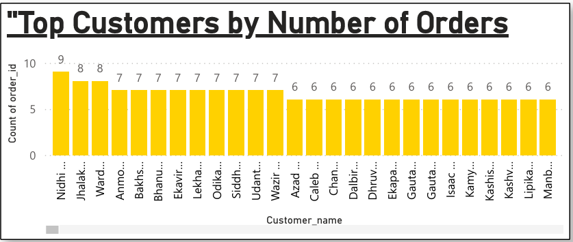

This bar chart highlights the top customers based on the count of their orders. The visual ranks customer names and indicates that the highest number of orders placed by any customer is 9, with several customers closely following at 8 and 7 orders. This helps identify the most engaged and loyal customers.

Slide 9
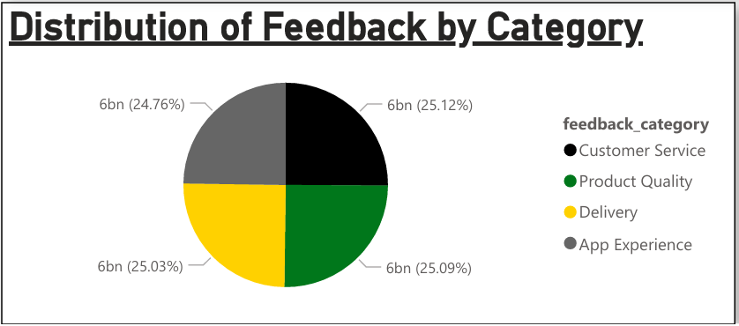
This pie chart highlights how customer feedback is distributed across key areas such as Customer Service, Product Quality, Delivery, and App Experience. The visual makes it easy to identify which aspects of the customer experience generate the most responses, helping prioritize service improvements.

Slide 10
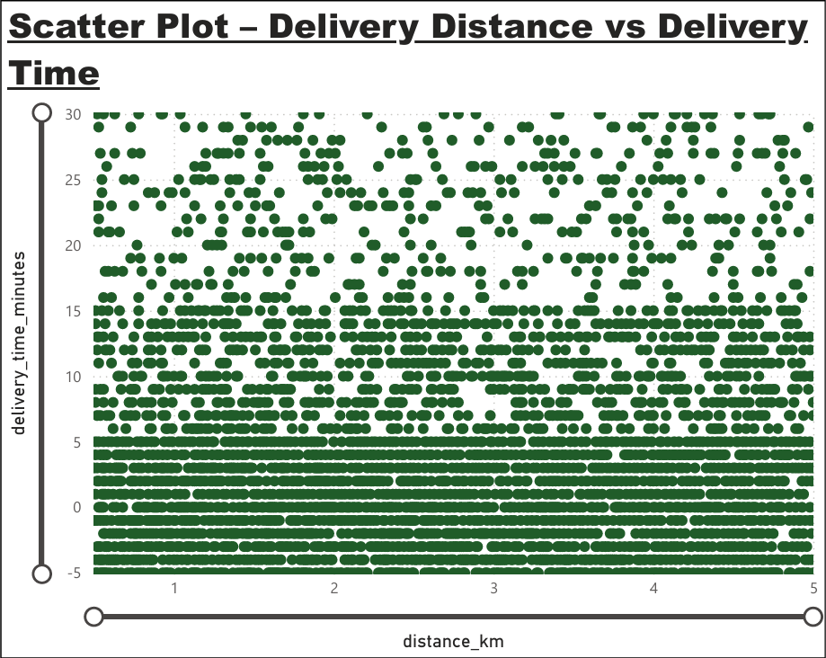
This scatter plot represents the relationship between delivery distance (in kilometers) and delivery time (in minutes). The plot shows clustered points suggesting that for most deliveries, regardless of distance variation between 1 to 5 km, the time taken remains under 30 minutes. It reflects consistency and efficiency in delivery times.

Slide 11
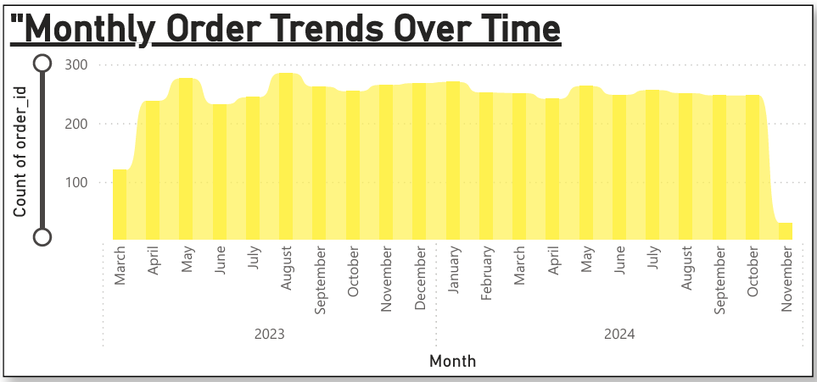
The line chart visualizes the monthly trend in the number of orders from March 2023 to November 2024. There is visible seasonality, with certain months showing peaks, indicating potential sales surges during specific periods. The trend helps identify high-performing months for strategic planning.

Slide 12
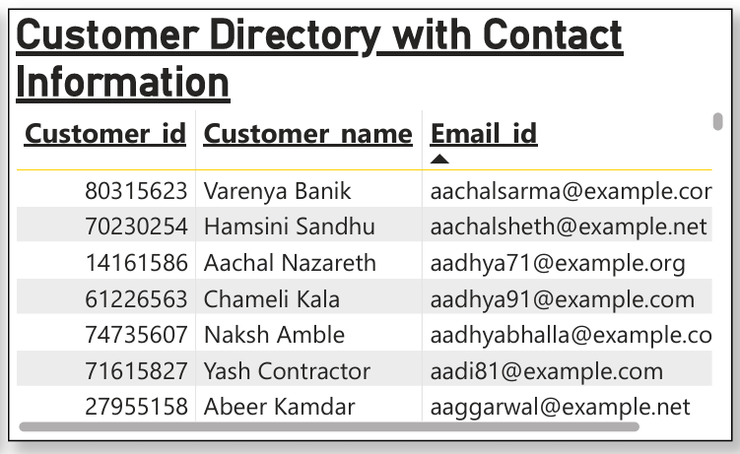
This table lists customer IDs, names, and email addresses, offering a detailed directory of customers. It supports CRM and marketing campaigns by providing essential contact data to target specific customer segments.

Slide 13
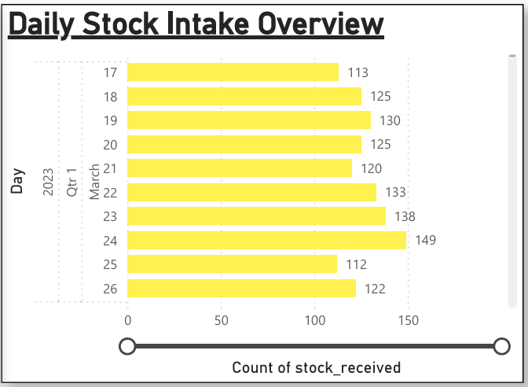
Shows the quantity of stock received daily starting from March 17, 2023 onwards. The data is represented across multiple days, though only part of the chart is visible due to screenshot cropping. Visible intake peaks around 149 units and fluctuates day-to-day. Reflects inbound stock volume trends over time. Helps evaluate restocking frequency and plan warehouse/logistics activities

Slide 14
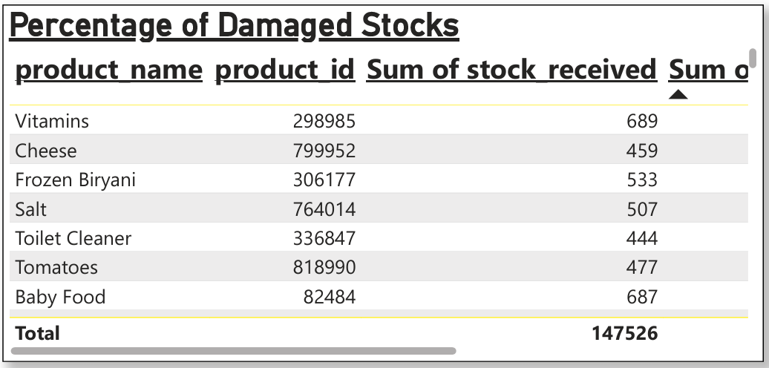

This table visualizes damage rates for various products, listing quantities received and damaged. Products like Cheese, Salt, and Tomatoes show relatively higher damage numbers. This insight is useful for quality control and supply chain improvements.

Slide 15
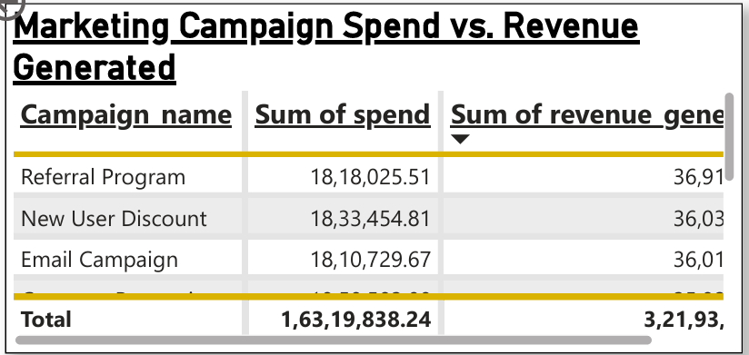
This table compares the investment made in each marketing campaign against the revenue it generated. It evaluates the performance and efficiency of campaigns and helps prioritize future marketing spend.

Slide 16
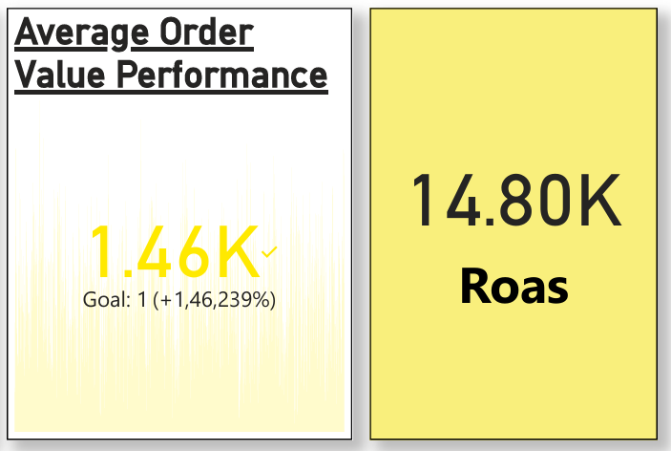
The “Average Order Value Performance” card shows an impressive AOV of ₹1.46K, significantly surpassing the set goal of ₹1. This is accompanied by an astounding growth figure of +1,46,239%, which—though possibly affected by a placeholder goal—clearly highlights a substantial increase in how much customers spend per order. This metric is crucial for assessing profitability per transaction and the effectiveness of upselling or bundling strategies.
Beside it, the “ROAS” (Return on Ad Spend) metric stands at ₹14.80K, indicating that for every unit of currency spent on marketing, the business is earning 14.8 times that amount in revenue. This strong ROAS value suggests highly efficient marketing campaigns and a healthy return from promotional investments, particularly important for optimizing budget allocation in future campaigns.

Slide 17
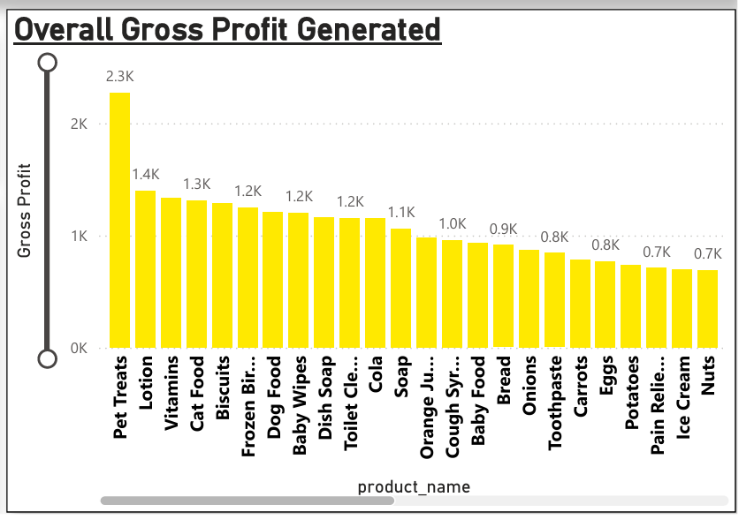
This bar chart presents the gross profit generated by each product. "Pet Treats" and "Lotion" stand out as the most profitable products. This helps identify high-margin items contributing significantly to overall profits.

Slide 18

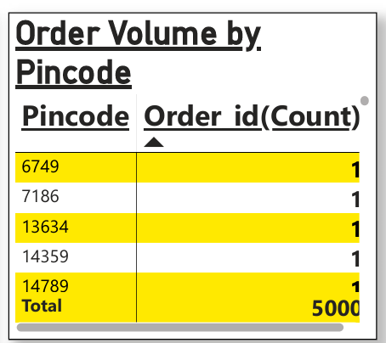
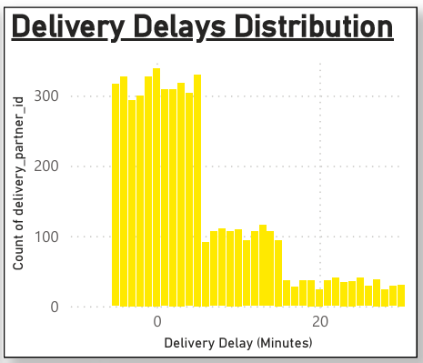
This table displays how many orders were delivered to each geographic area. It offers insight into location-based demand and can inform regional sales strategies.
This histogram presents the frequency of delivery delays across different time intervals. It helps identify patterns and ranges of delays, informing delivery process improvements.

Slide 19
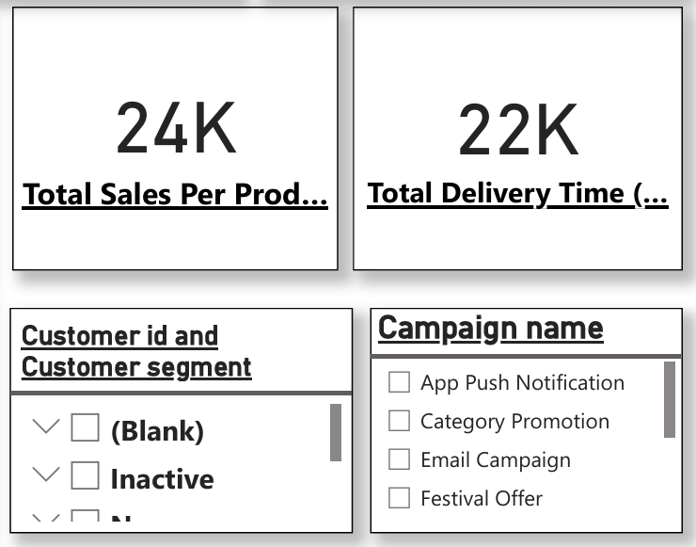
This visual contains four elements—two KPIs and two slicers—
Slicers:-
Customer Segment Slicer: Filters data by customer type (e.g., Inactive, New, Regular, Premium) to analyze behavior and contribution.
Campaign Name Slicer: Allows filtering by marketing campaigns (e.g., App Push, Category Promo, Email, Festival) to measure their impact on key metrics like sales and retention.
KPIs:-
Total Sales Per Product: Indicates that 24,000 units have been sold across all products. This metric provides a high-level view of overall product movement, helping assess which products are driving sales and informing decisions related to demand forecasting and inventory management.
Total Delivery Time: Aggregates to 22,000 minutes spent on order deliveries. This KPI helps evaluate overall delivery efficiency and can highlight regions or time periods where delays occur, supporting improvements in logistics and customer satisfaction.

Slide 20
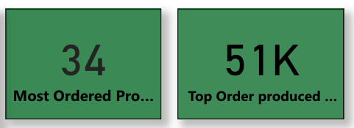
The first KPI card, titled “Most Ordered Product”, shows the number 34, indicating that a single product has been ordered 34 times, making it the most frequently purchased item in the dataset. This highlights customer preference or high utility, which can guide stock prioritization, promotional focus, or even bundling strategies.
The second KPI card, labeled “Top Ordered Product”, displays a value of 51K, which represents the total quantity sold for the highest-selling product across all transactions. This emphasizes the sheer volume or popularity of a particular product and is essential for recognizing demand trends and ensuring consistent availability of that item in inventory.

Slide 21
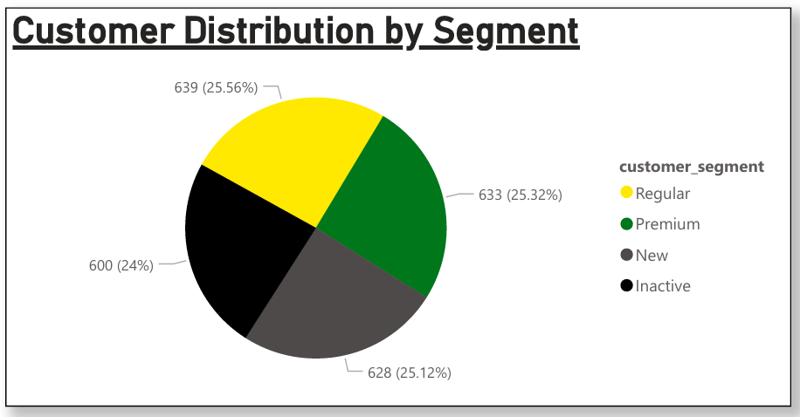
This pie chart shows the percentage of customers across different segments: Regular, Premium, New, and Inactive. Each segment is almost equally distributed, highlighting the diverse composition of the customer base.

Slide 22
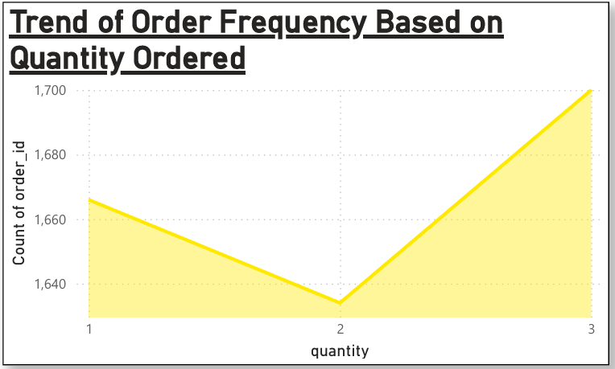
This line chart shows how frequently orders were placed based on the quantity ordered (1, 2, or 3 units). Most orders fall in the lower quantity range, suggesting customers typically purchase fewer items per order.

Slide 23
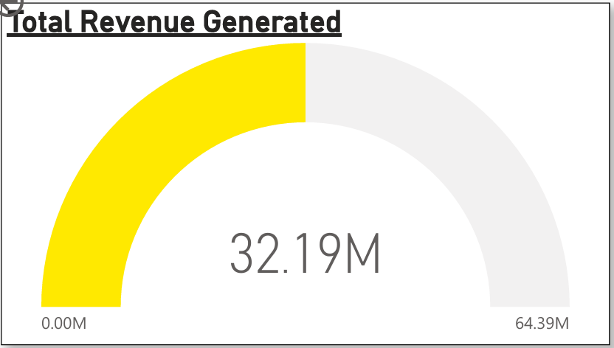
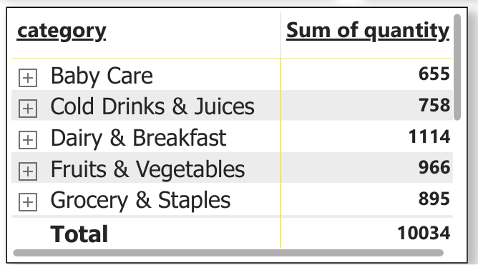
This KPI indicates the proportion of repeat customers. It reflects customer loyalty and the effectiveness of engagement strategies.
This visual is a matrix table summarizing the total quantity of products sold per category, offering a clear view of demand across major product segments:
The “Dairy & Breakfast” category leads with 1,114 units sold, followed by Fruits & Vegetables at 966 and Grocery & Staples with 895. Other categories like Cold Drinks & Juices (758) and Baby Care (655) also contribute significantly. The overall total sales quantity across all listed categories is 10,034 units.

Slide 24
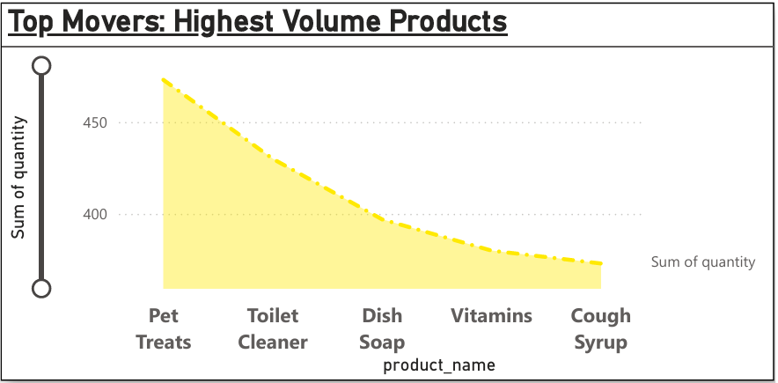
This bar chart lists the products with the highest sales volume, with "Pet Treats," "Toilet Cleaner," and "Dish Soap" leading in quantity sold. It highlights the most popular or frequently purchased items.

Slide 25
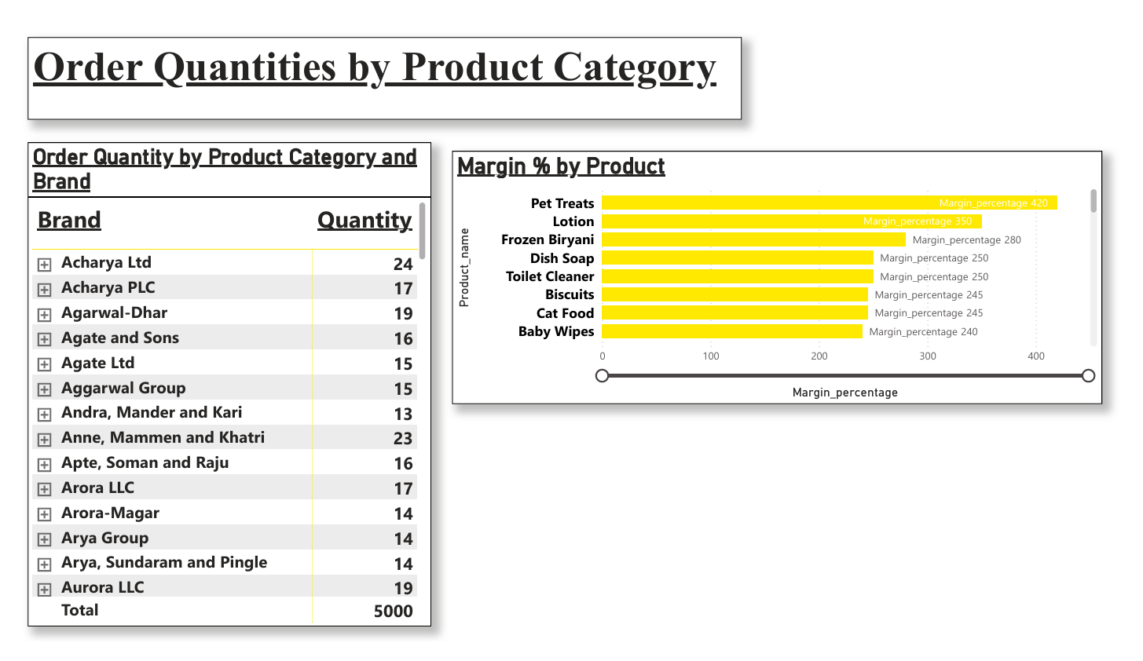
This visual provides insights into product performance from two angles—
The left table lists brands alongside the quantity of orders they received. Brands like Acharya Ltd (24 units) and Anne, Mammen and Khatri (23 units) top the list, while the total across all brands sums up to 5,000 units. This helps identify the most demanded brands, useful for stock planning and vendor management.
On the right, a bar chart shows the margin percentage by product, with Pet Treats leading at 420%, followed by Lotion (350%) and Frozen Biryani (280%). Products like Dish Soap, Biscuits, and Toilet Cleaner also show healthy profit margins above 240%.
Together, these visuals highlight which brands drive volume and which products drive profitability, supporting balanced decision-making between sales volume and margin optimization.

Slide 26
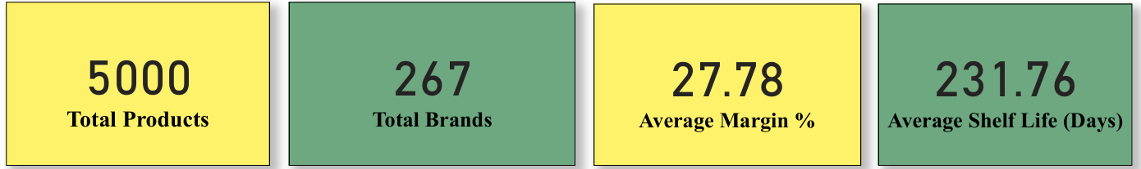
This visual showcases four key performance indicators (KPIs) related to product inventory and profitability:
The first card shows 5,000 total products, reflecting a diverse and extensive catalog available for customers.
The second card highlights 267 total brands, indicating a wide supplier base and strong product variety.
The third card reports an average margin of 27.78%, which is a healthy profitability figure across all products.
The fourth card reveals an average shelf life of 231.76 days, suggesting that products generally have a long usability span, which aids in better inventory turnover and reduced waste.
Together, these metrics provide a quick overview of assortment scale, brand partnerships, financial health, and product longevity.

Slide 27
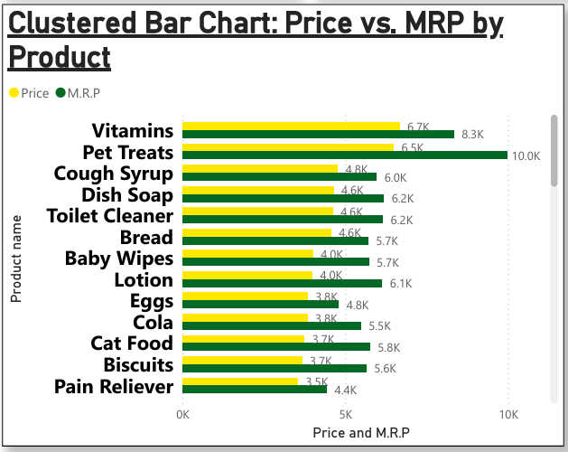
This clustered bar chart compares the selling price against the MRP for various products. It highlights discounting strategies or price sensitivity across products, with some products being sold close to or even at MRP.

Slide 28
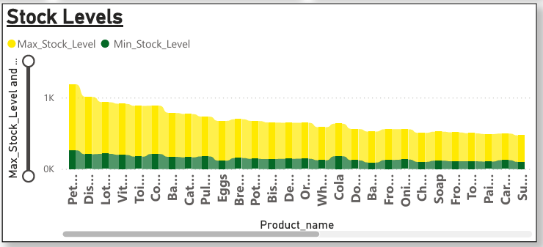
This chart compares maximum and minimum stock levels for various products. It informs stock planning and ensures products remain within optimal inventory thresholds.

Slide 29
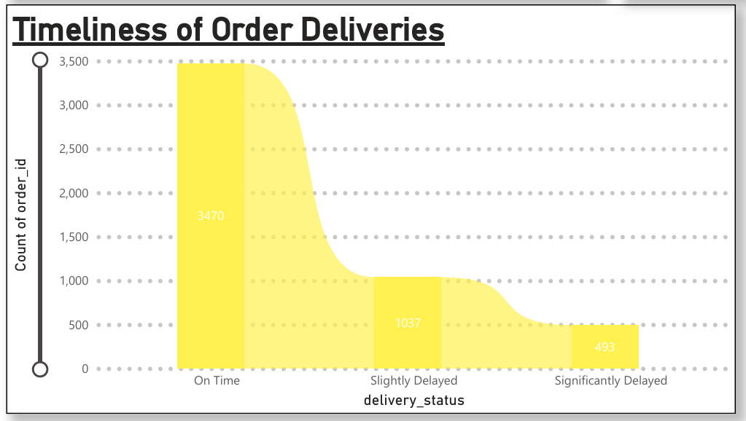
This column chart categorizes order deliveries based on punctuality. It highlights how many orders were delivered on time versus those that were delayed, reflecting operational reliability.

Slide 30
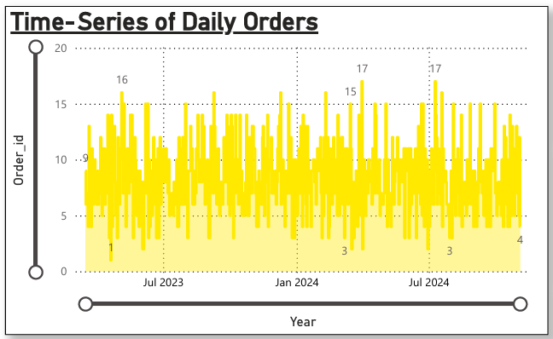
This line chart presents a detailed view of daily order activity over a period of time. It illustrates fluctuations in order volumes, capturing both peak sales days and periods of lower activity. The trendline helps in understanding short-term spikes due to campaigns or seasonal effects, as well as long-term buying behavior. By observing these patterns, businesses can optimize inventory planning, align staffing with demand cycles, and make informed decisions about promotions and logistics.

Slide 31
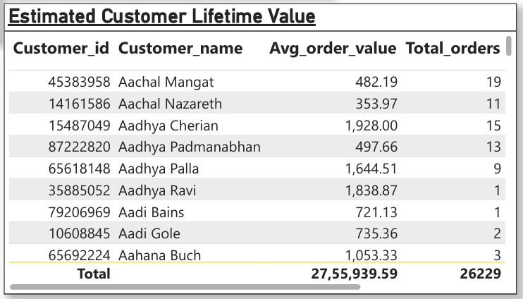
This table presents the calculated lifetime value of each customer, derived from their average order value and total number of orders placed. It highlights which customers have contributed the most revenue over time and provides insights into long-term profitability. By understanding which segments or individuals bring the highest lifetime returns, businesses can develop retention strategies, personalize marketing campaigns, and allocate resources more effectively toward valuable customer relationships.

Slide 32
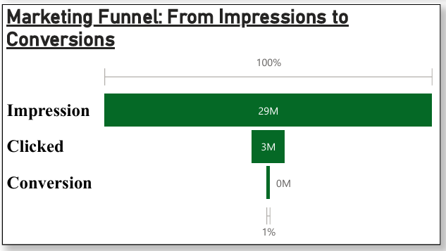
This funnel chart breaks down the stages of a marketing campaign, beginning with total impressions and narrowing down to actual customer conversions. Each stage of the funnel—impressions, clicks, and conversions—shows the number of users retained at that level. The visual provides a clear view of where customer engagement drops off, helping to pinpoint inefficiencies and optimize campaign elements to increase conversion rates. It supports performance evaluation of marketing efforts and assists in identifying opportunities to improve user experience and targeting.

Slide 33
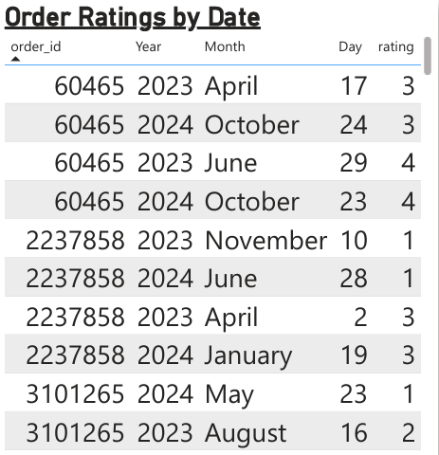
Order Ratings by Date Table: This table displays individual order ratings along with their corresponding date details such as order ID, year, month, and day. It helps track how customer sentiment has varied over time and also allows cross-checking with specific orders. By reviewing this table, users can identify if certain months or years tend to attract lower or higher ratings.

Slide 34
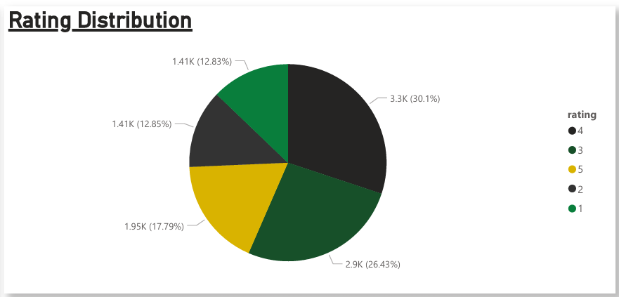
This pie chart breaks down the distribution of customer ratings from 1 to 5. Rating 4 dominates the feedback with 30.1%, followed by rating 3 (26.43%), indicating that most customers are moderately satisfied. The chart quickly communicates customer satisfaction levels and highlights potential quality improvement needs if lower ratings are significant.

Slide 35
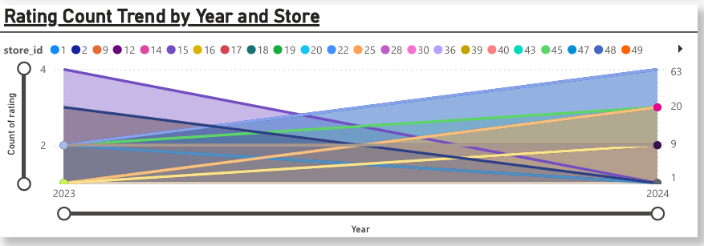
This line chart shows how rating counts have changed over the years for different stores (represented by store IDs). Some stores show an increase in ratings while others decline. This visual helps compare performance across stores and spot trends—whether customer feedback volume is rising, declining, or remaining steady.

Slide 36
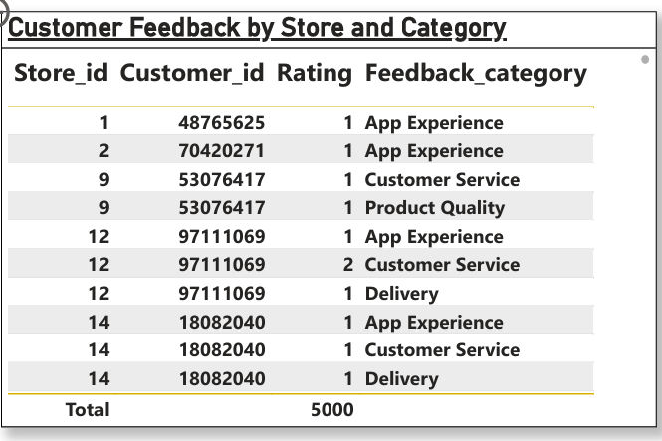
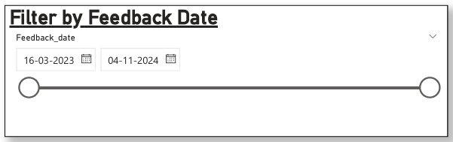
This date slicer enables filtering of feedback records by a specific time range. By adjusting the date slider, users can focus their analysis on recent trends or historical patterns, which is essential for temporal comparison and decision-making based on evolving customer input.
This table details feedback records including store ID, customer ID, rating, and feedback category (e.g., App Experience, Customer Service). It provides a granular look at how customers rate various aspects of service. Repeating customers across feedback categories also suggest that multiple service dimensions are evaluated per customer.

Slide 37
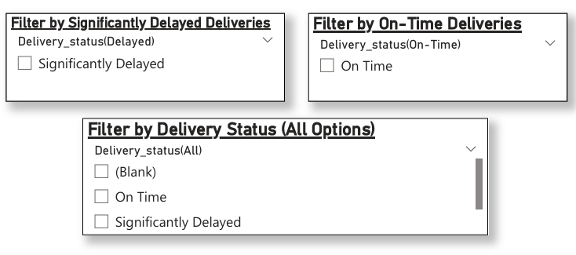
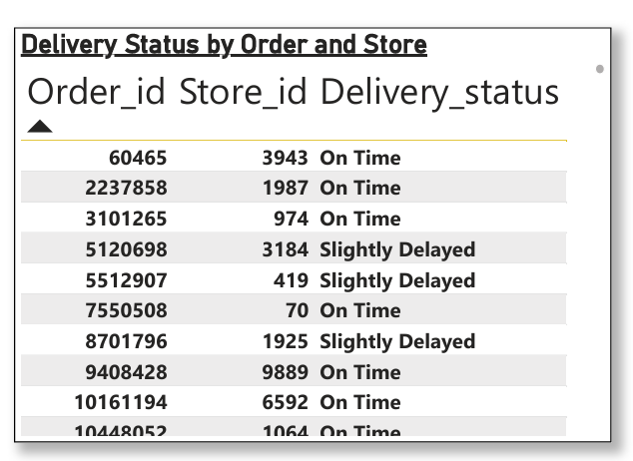
Significantly Delayed: Filters orders with major delays to identify underperforming stores or regions needing improvement.
On Time: Shows only timely deliveries, useful for measuring punctuality performance.
All Options: Includes all delivery statuses for a complete and customizable analysis view.
This table shows the delivery performance of orders by linking order ID and store ID with their delivery status (e.g., On Time, Slightly Delayed). It offers insight into how punctual each store’s delivery service is, which is crucial for logistics performance and customer satisfaction.

Slide 38
Key Findings:-
Diverse Customer Base: Customers are evenly spread across segments, with a few showing strong loyalty through repeated purchases.
Top Products & Profitability: Items like Pet Treats and Lotion lead in both sales volume and profit margins.
Efficient Deliveries: Most deliveries are completed within 30 minutes, though some delays highlight areas for operational improvement.
Effective Marketing: Campaigns show high ROAS , indicating strong returns on marketing investments.
Seasonal Trends: Monthly sales spikes reveal clear seasonal demand patterns, aiding in better planning.

Slide 39
Conclusion:-
This analysis provided a comprehensive overview of Blinkit's sales performance, customer behavior, product profitability, and operational metrics. Key insights include the identification of high-value products and customers, efficiency in delivery operations, and the effectiveness of marketing campaigns.
These findings can directly support strategic decision-making by:
Informing product assortment and pricing decisions based on performance data.
Enhancing delivery systems to address delays and improve customer satisfaction.
Guiding targeted marketing initiatives with proven ROI.
Enabling proactive planning aligned with seasonal demand patterns.
By leveraging these insights, Blinkit can strengthen customer relationships, boost profitability, and streamline its sales and supply chain operations.

Slide 40
Thank you
Shreya Das Email:- shreyadas0413@gmail.com

